Slide 1
Engineering Management
Planning Production Activity
PART 1
Lecture 31,32,33

Slide 2
Objectives
Describe the position of the engineer in the production process.
Describe considerations in planning manufacturing facilities.
Be able to use production planning tools.
Describe the major methods used for production planning and control.

Slide 3
Vital nature of Production
Alexander Hamilton is reported to have said the following:
“Not only the wealth, but the independence and security of the country appear to be materially connected to the prosperity of manufacturers.”

Slide 4
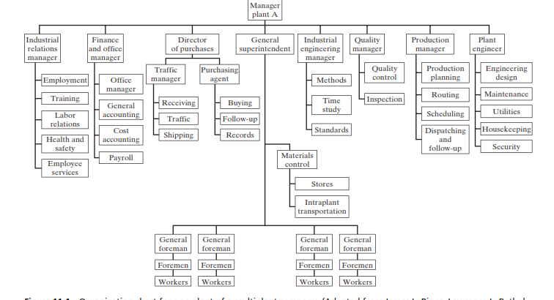
The engineer in Production activity

Slide 5
Future demands on Manufacturing engineers.
The manufacturing engineer of the will be faced with new challenges in the form of an
Environment of exploding scope [increasing product sophistication and variation ,a global manufacturing environment, and extensive social and economic changes];
Multiple roles[with the manufacturing engineer acting as an operations integrator and manu-facturing strategist as well as a technical specialist];
advanced tools [including more powerful computer hardware, more and larger databases, a greater choice of software and expert systems, and advanced CAD/CAM (computer-aided design/manufacturing) systems]

Slide 6
Planning manufacturing facilities
Plant location
Plant layout
Process layout
Product layout

Slide 7
Quantitative tools in production planning
Inventory control
Types of inventory
Most types of manufacturing processes begin with some type of raw material (sheet steel, lumber, leather) that requires processing. They add purchased parts (valves, switches, hinges), and consume supplies (cutting oils, time cards, drill bits).

Slide 8
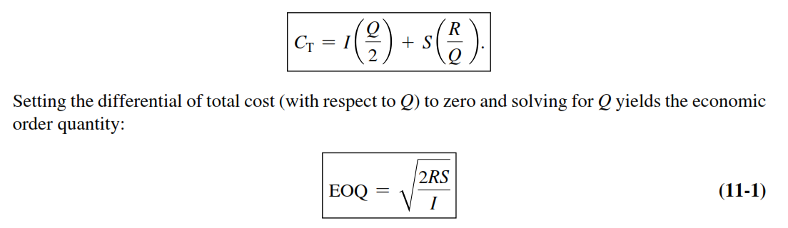
Quantitative tools in production planning
Economic Order Quantity.
Consider an inventory item for which the annual requirement is R units.
Storing each unit of the item in inventory will cost I dollars per year.
These storage costs include interest on the working capital invested in the unit, warehouse expense, and threat of deterioration, theft, and obsolescence while the unit is in storage.
If, every time the last item is used, you renew the inventory with a batch of Q units, your average inventory will be Q/2 units and you will need R/Q batches per year. Each such batch involves an ordering or setup cost of S dollars.
The total annual cost C T of that inventory item is, therefore,

